Slide 1
Capstone Project
CoronaVirus Tweet Sentiment Analysis
Rupali Sawant

Slide 2
Content
Problem Statement
What is sentiment analysis
Data Summary
Exploratory Data Analysis
Data Processing
Model Training
Challenges Faced
Conclusion

Slide 3
Problem Statement
We are tasked with predicting the sentiment of the tweets data which has been pulled from twitter. This is a supervised ml classification problem.
Our model helps to understand the sentiment behind a particular tweet and build a sentiment prediction algorithm around it.

Slide 4
What is Sentiment Analysis
Sentiment analysis is a natural language processing technique used to determine whether data is positive , negative or neutral.
Sentiment analysis is often performed on textual data to help businesses monitor brand and product sentiment in customer feedback and understand customer needs.

Slide 5
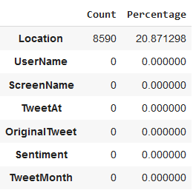
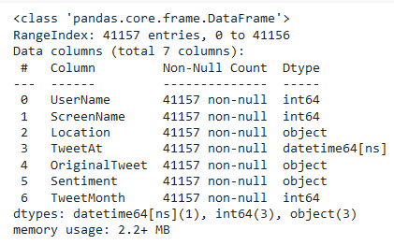
Data Summary
In our dataset contains:
-Total number of rows are 41156.
-Location column has some null values.
-Data of type int64(2) and object(4) are only present.
-About 20.8% null values are present in location column, whereas all other columns are clean.

Slide 6
Exploratory Data Analysis
-Exploring head and tail of the data to get insights on the given data.
-Looking for null values and removing them if it affects the performance of the model.
-Removing the unimportant text from the Original Tweet which the model does not understand by using a function.
-Classifying the 5 labels of sentiment column into 3 labels i.e positive, negative and neutral.
-Applying a stemming function on the given text. Stemming is an operation which reduced the word to its base word or stem in such a way that the words of similar kind lie under a common stemm. Example: ‘cared’ and ‘bumped’ will be stemmed as ‘care’ and ‘bump’.
-Changing the string format of TweetAt column into date-time format using a function.

Slide 7
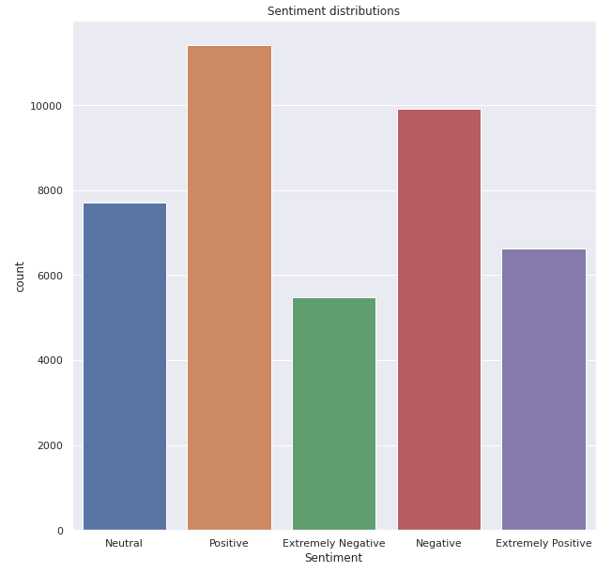
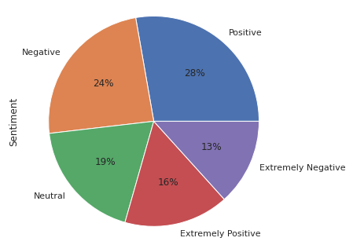
Sentiment Distribution
The Sentiment column is the dependent variable which consist of 5 different labels which are positive , negative, neural, extremely positive and extremely negative.
From the sentimental distribution , we can see that 28% people tweets something positive.

Slide 8
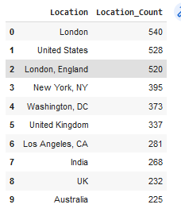
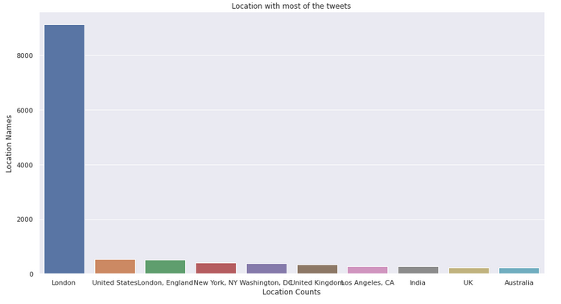
Top Locations which has most tweets from them
London has most active people who tweets related to COVID-19
India Ranks 7th in most active locations an average of 4.4 twets related to COVID per day.

Slide 9
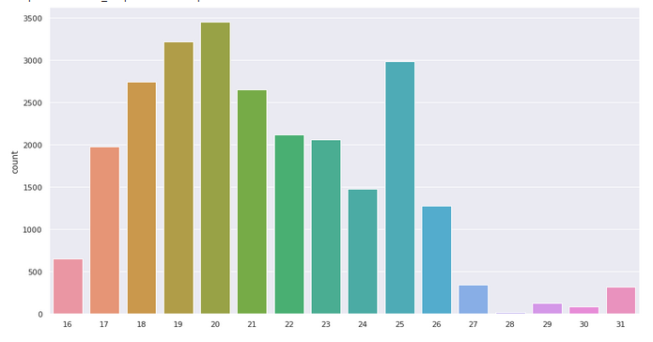
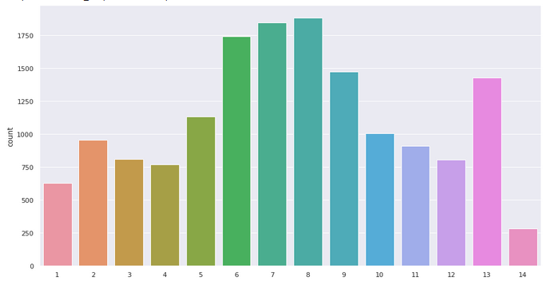
List of most tweets were made
From the above subplot we can see that March and April months in which most tweets were made.

Slide 10
Data Processing
The processing of the text data is an essential step as it makes the raw text ready for mining, i.e , it becomes easier to extract information from the text and apply machine learning algorithms to it. If we skip this step then there is a higher chance that you are working with noisy an inconsistent data.
The objective of this step is to clean noise which is less relevant to find the sentiment of tweets such as punctuation, special characters, numbers and terms which don’t carry much weightage in context to the text.

Slide 11
Model Training

Slide 12
Count Vectorizer Method
In order to use textual data for predictive modeling , the text must be parsed to remove certain words- this process is called tokenization. These words need to then be encoded as integers , or floating-point values, for use as inputs in machine learning algorithm.
Scikit-learns’s CountVectorizer is used to convert a collection of text documents to a vector of term/token counts. It also enable the pre-processing of text data prior to generating the vector representation. This functionality makes it a highly flexible feature representation module for text.

Slide 13
Models Used
Logistic Regression
Multinomial Naïve Bayes Classifier
Word Count with CountVectorizer
TF-IDF Method

Slide 14
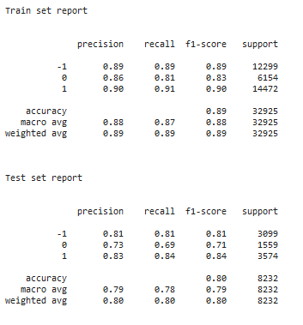
Logistic regression matrix
Accuracy Score : 0.8040
Precision Score : 0.8046
Recall Score : 0.8040
F1- Score : 0.8038

Slide 15
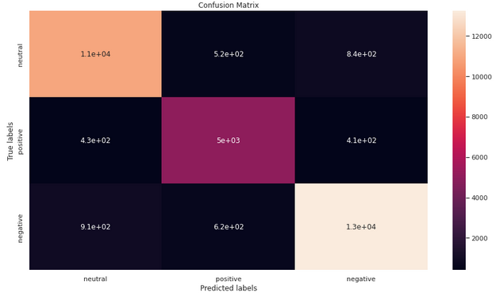
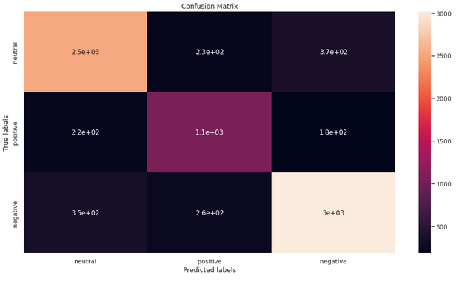
Logistic Regression Confusion matrix

Slide 16
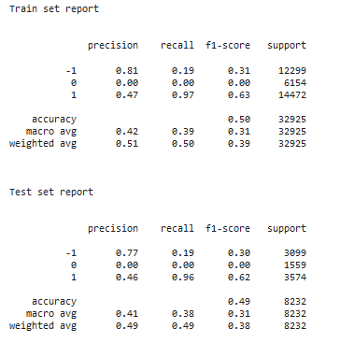
Decision trees classifier metrics
Accuracy Score : 0.5020
Precision Score : 0.4513
Recall Score : 0.9626
F1- Score : 0.6264

Slide 17
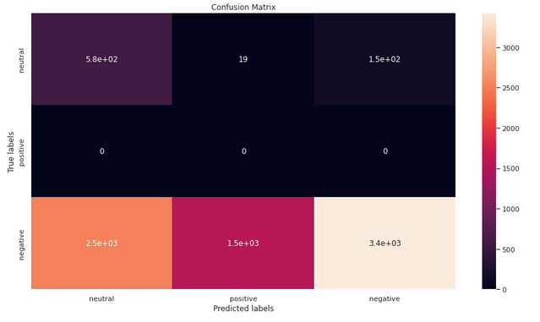
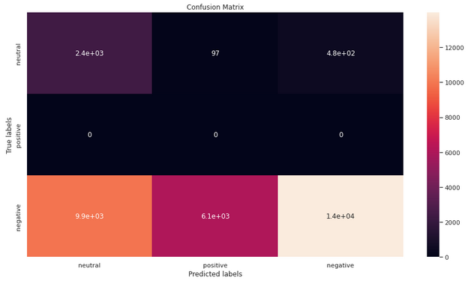
Decision tree confusion metrics

Slide 18
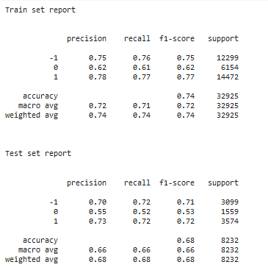
Multinomial Naïve Bayes matrix
Accuracy Score : 0.6856
Precision Score : 0.7348
Recall Score : 0.7439
F1- Score : 0.7225

Slide 19
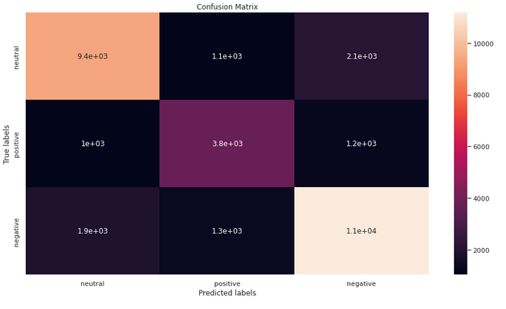
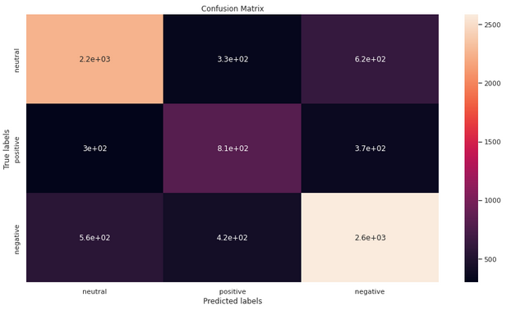
Multinomial Naïve Bayes Confusion Metrics

Slide 20
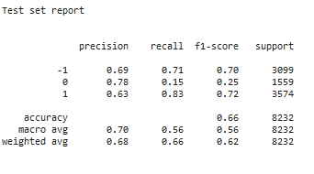
Hyperparameter tuning

Slide 21
Challenges faced
Pre-processing the data was one the challenges we faced which includes removing unimportant text from the data so as to not hinder the performance of our classification model.
Exploratory the location column was a challenge task as there were a large number of unique location values in the given dataset. So we had to settle for the top 10 locations with the highest number of tweets.
Selecting the appropriate vectorizer to maximize the performance of our model was one of the challenges.

Slide 22
Conclusion
We are finally at the conclusion of our project.
Coming from the beginning we did EDA on the dataset and also cleaned the data according to our needs. After that we draw the relevant conclusions from the given data and then we trained our model on logistic regression.
Given the size of data and the amount of irrelevance the data , the above score is good.

Slide 23
Thank You

